Slide 1
Big Mountain Resort Ticket Pricing
The purpose is to find out that the ticket pricing for Big Mountain Resort based on all possible variables.

Slide 2
Recommendation and key findings
We have been done modeling to review potential scenarios for either cutting costs or increasing revenue.
After certain processes such as data wrangling and building machine learning models, we roughly get a result that our modelled price is 95.87 dollars. Comparing with our current ticket price, 81 dollars, this result looks like not very acceptable.
After setting up several models between Big Mountain resorts and all other resorts in Montana, Big Mountain resorts basically has advantage among all areas such as longer vertical drop, larger snow making area, higher numbers of chairs, more fast quads, higher numbers of runs, longest runs, largest skiable terrain area and no tram.

Slide 3
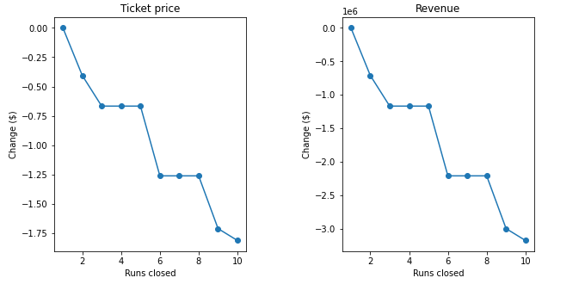
Modeling results and analysis
Accroding to the graph, we can say that closing one run will not affect the change in ticket price. Closing 2 or 3 runs will reduce the revenue and ticket price obviously. Another big drop happens on closing 6 runs.
Scenario 1

Slide 4
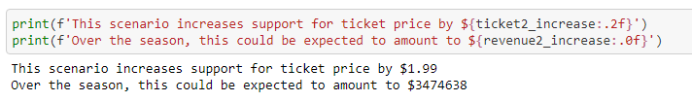
Scenario 2
The second plan is to increase the vertical drop by adding a run to a point 150 feet lower down but requiring the installation of an additional chair lift to bring skiers back up, without additional snow making coverage.
Over the season, this could help ticket price increased about $1.99

Slide 5
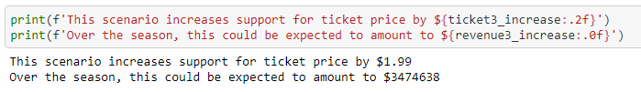
Scenario 3
Same as number 2, but adding 2 acres of snow making cover
The result will remain the same which incresing this small area of snow making area makes no differences from last result.

Slide 6
Scenario 4
Increase the longest run by 0.2 mile to boast 3.5 miles length, requiring an additional snow making coverage of 4 acres
This option also makes no difference on result from scenario 2.

Slide 7
Summary and conclusion
From the modeling we are currently performing now, increasing $1.99 of ticket pricing is reasonable with increasing the vertical drop by adding a run to a point 150 feet lower down but requiring the installation of an additional chair lift to bring skiers back up, without additional snow making coverage. Comparing the next 2 senerioes, this plan will keep the maintanence fee low. For future improvements, Big Mountain Resort can try to adjust number of fast quads.

